Slide 1
INFO251 – Applied Machine Learning
Lab 5
Qutub Khan Vajihi

Slide 2
Announcements
PS4 has been released yesterday ; due 17th March 11:59PM PST.
You will be implementing gradient descent from scratch. You’d want to optimize your code by using vectorization wherever possible. Else it make take too long to run!
10 students signed up for 7AM alternate quiz timings and we have reached out to them for confirmation. If you haven’t got the email, you’re taking it at the regular time at 9:40AM.

Slide 3
Agenda
Revisiting Overfitting
Regularization
Ridge / L2
Lasso / L1
Notebook – Regularization using sklearn

Slide 4
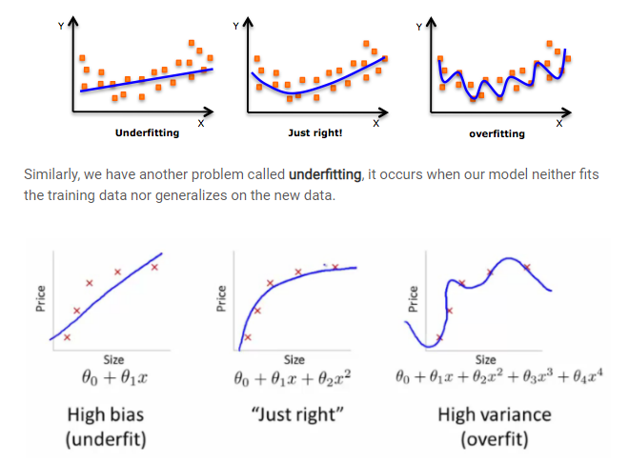
So. Overfitting?
Adding too many features to our model may help fit the training set very well but fail to generalize to new examples (test data).
The model “memorizes” the data.

Slide 5
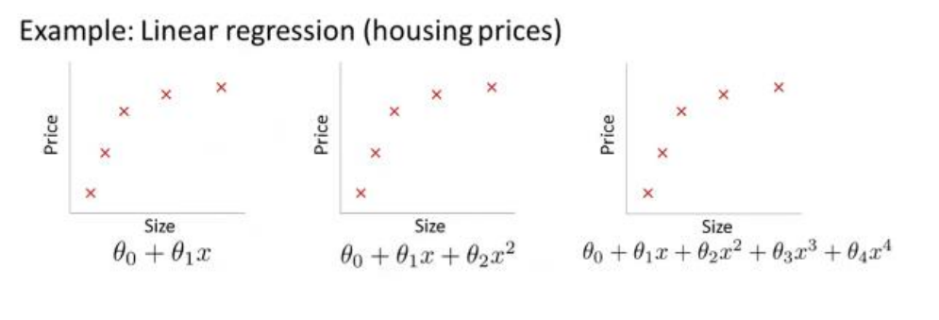

Slide 6
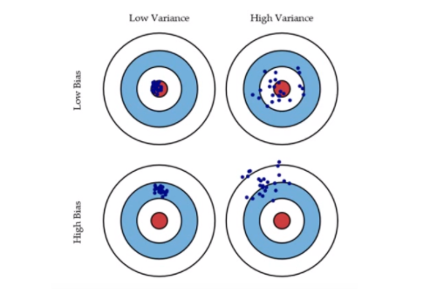
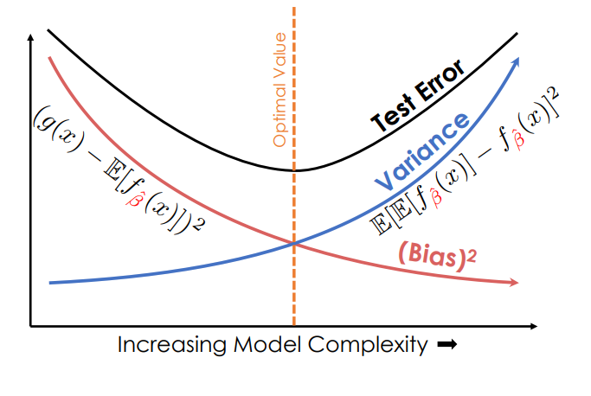
Bias – The expected deviation between the predicted value and the true value
Variance – The variability in the predicted value across different training datasets.
We’ll be discussing this in more detail later in the course!

Slide 7


Slide 8
Ok, how can we avoid overfitting?
Better model? – yes, but we’ll look at this later.
Dimensionality reduction? – again, later.
Better feature selection? – yes, but difficult to handpick few features
Increase data with variance? – not easy to get more data
REGULARIZATION!
Retain all features, but reduce their magnitude
Works great when we have lots of features, and each contribute a bit to prediction

Slide 9
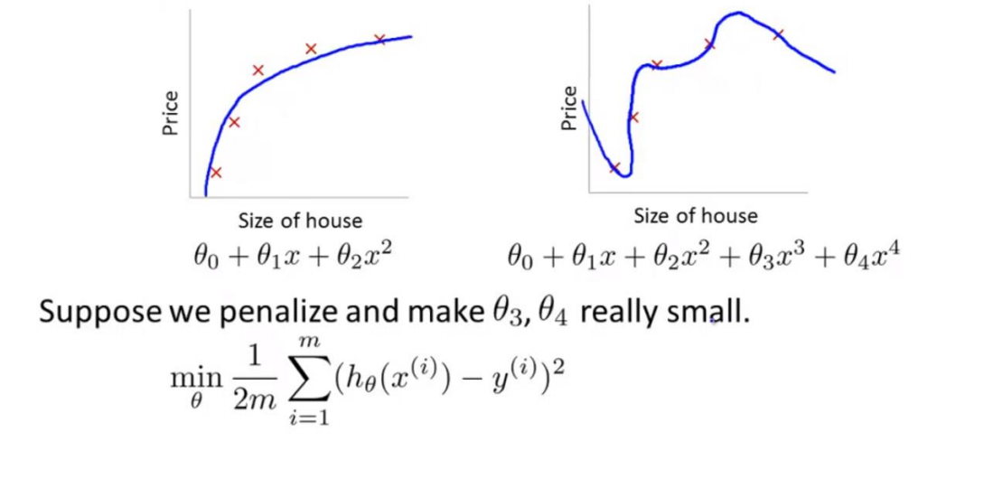
Intuition

Slide 10
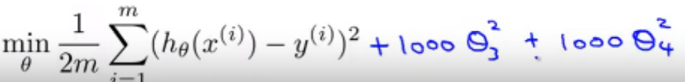
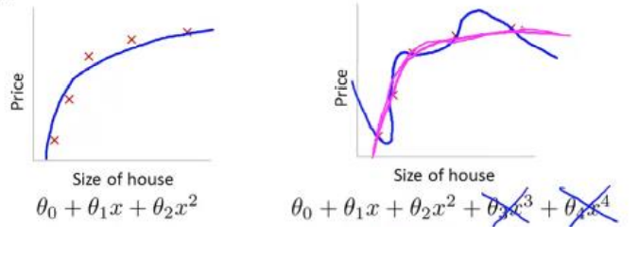
By adding a regularization cost, we are essentially forcing the parameters to go down
in magnitude, or sometimes even become 0. In a way, you switch some of them off.

Slide 11
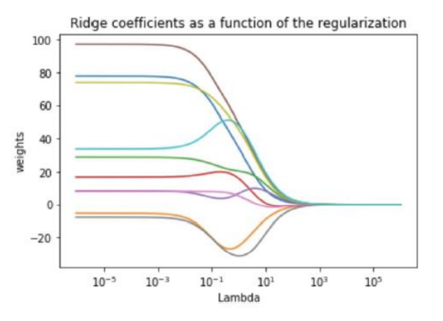
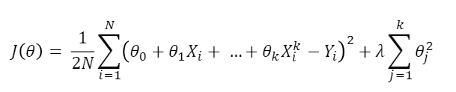
Ridge Regularization
So in the context of OLS, here is our loss function again –
When we add a L2-norm penalty, we get this –
Lambda is the regularization parameter, and beta-squared is the penalty.
Remember to normalize data!

Slide 12
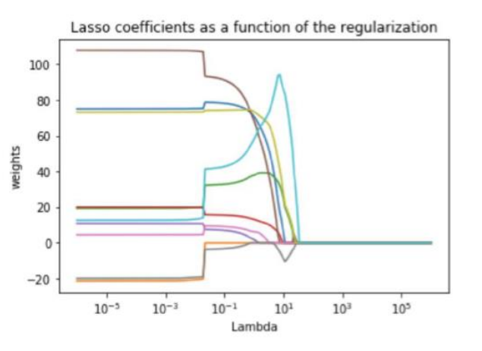
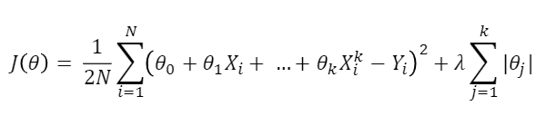
Lasso Regularization
LASSO - least absolute shrinkage and selection operator
Here the penalty is L1-norm–
In Lasso, as we increase the lambda the weights shrink, as in ridge, but in a way such that more and more coef. become precisely zero, unlike in ridge.
Why?
Gradient of regularizer term is constant lambda always, unlike ridge.
So the pressure to reduce weights is also constant. Therefore, they will drop to zero.
However in Ridge, pressure to reduce weight decreases as weight decreases – so the weights will tend to zero but not reach exact zero, they will just get small.

Slide 13
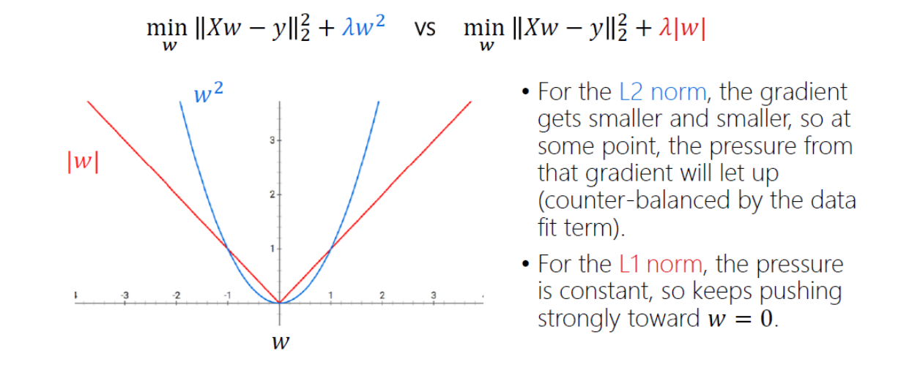
Ridge vs Lasso

Slide 14

There’s more! Elastic Net Regularization
Lasso and Ridge both have pros and cons -
Ridge is differentiable (also a nice closed form solution). But Ridge cannot be used for variable selection.
Lasso is not differentiable. But Lasso can eliminate features. But it does not work well with multicollinearity.
Elastic Net linearly combines L1 and L2 penalties –

Slide 15
So what is the point of all this again?
Overfitting is bad!
Modeling is difficult when you have too many features.
Regularization gives you a way of parametrically controlling the model complexity.
Ofcourse, there are tradeoffs – increased bias, decreased variance.
Best way to find the optimal lambda? Cross-Validation!

Slide 16
Over to the notebook.

